Slide 1

Exam AZ-304: Microsoft Azure Architect Design Crash Course
Tim Warner

Slide 2


Tim Warner
Based in Nashville, TN, US
Central time zone
MCT, MVP
Twitter: @TechTrainerTim
Badge: TechTrainerTim.com

Slide 3
Day 1 of 2 Agenda
Introduction
Azure infrastructure design (25-30%)
Business continuity design (10-15%)
Monitoring design (10-15%)

Slide 4
Day 2 of 2 Agenda
Content catch-up
Identity and security design (25-30%)
Data storage design (15-20%)
Exam AZ-304 strategy

Slide 5
Course Materials
timw.info/az304

Slide 6
A Different Kind of Training
We'll learn by doing – at least 80 percent demo
Visual, case study approach
This is an expert certification, so we move quickly and assume intermediate-level Azure skills
10-minute break at midpoint
I’m here to answer your questions – take advantage of this!
Use the Q&A panel

Slide 7
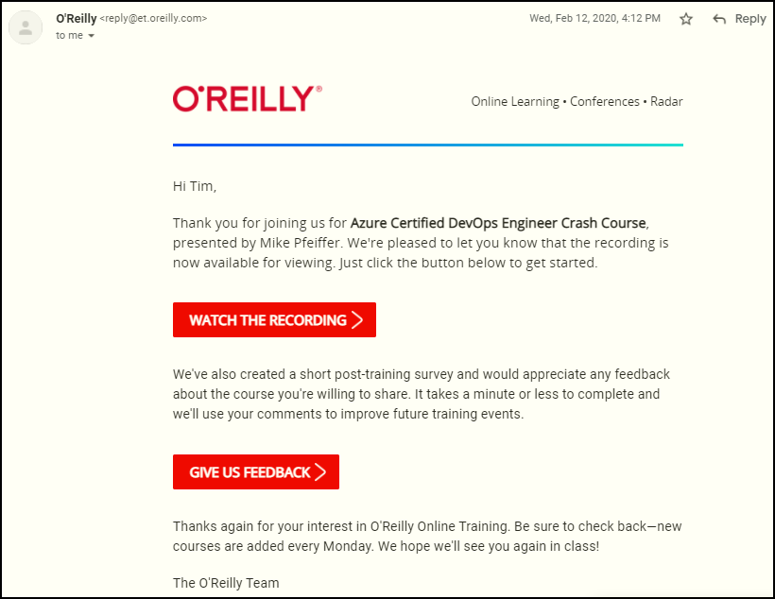
Session Recordings

Slide 8

Session Recordings

Slide 9

Session Recordings

Slide 10


Session Recordings

Slide 11
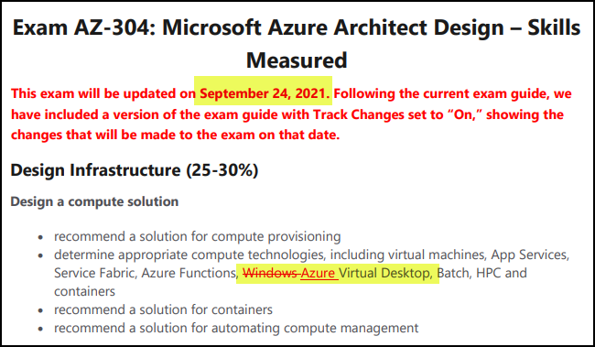
Exam AZ-304 Latest Changes

Slide 12
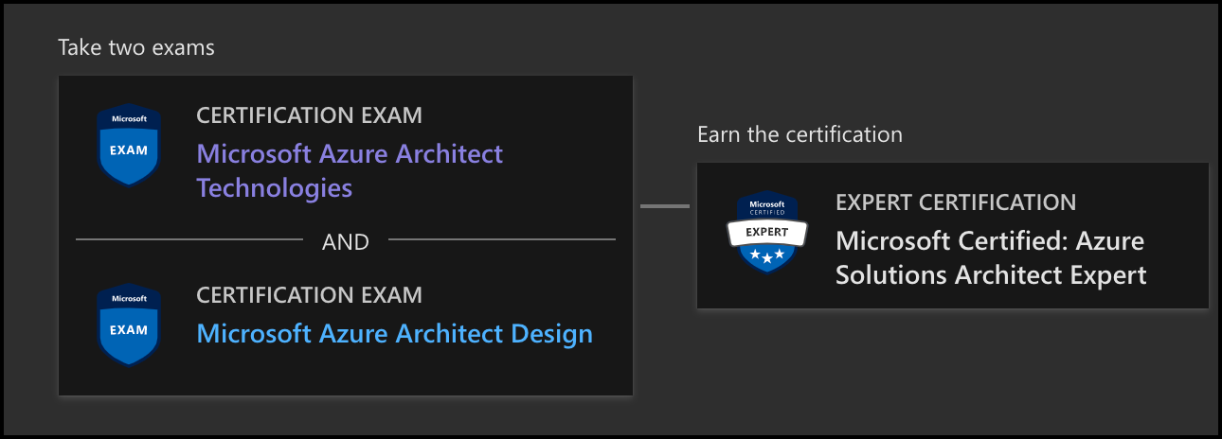
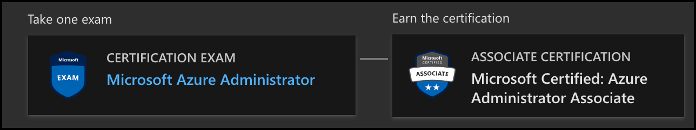
Azure Architect Certification
AZ-303
AZ-304
AZ-104

Slide 13

Tim's "Tower Bridge" Certification Study Model

Slide 14
Thank you!
Course materials: timw.info/az304
Twitter: @TechTrainerTim
Work: timw.info/ps
Web: TechTrainerTim.com

Slide 15

VM Scale Sets

Slide 16
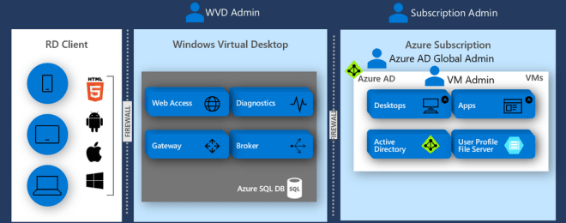
Windows Virtual Desktop (WVD)
timw.info/travis

Slide 17

Availability Set

Slide 18

Availability Zone

Slide 19

VM Networking

Slide 20

Load Balancing

Slide 21

VNet Peering

Slide 22

Hybrid Networking

Slide 23

Network Virtual Appliance

Slide 24

Azure Load Balancer

Slide 25

Application Gateway

Slide 26

Traffic Manager

Slide 27

Front Door Service

Slide 28


Docker Container Lifecycle
https://timw.info/3635f

Slide 29
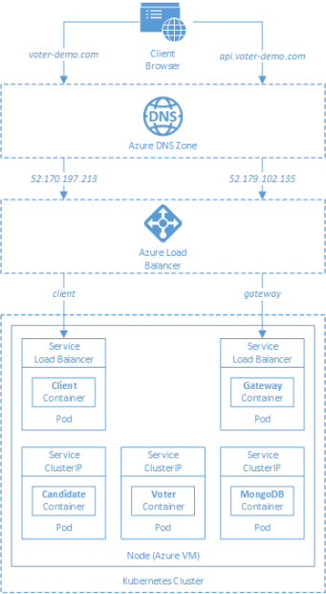
AKS

Slide 30

Azure Backup

Slide 31

Azure Site Recovery

Slide 32
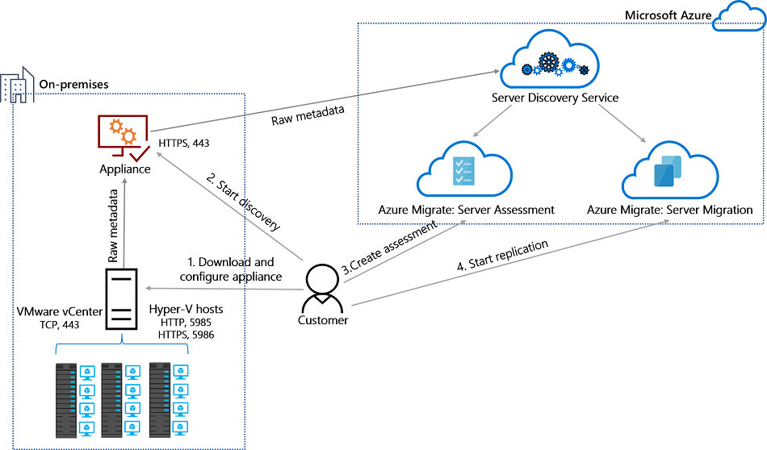
Azure Migrate

Slide 33

Azure Monitor

Slide 34

Log Analytics

Slide 35

Sentinel

Slide 36

Tenant vs. Subscription

Slide 37

Hybrid Identity

Slide 38

Azure AD B2C

Slide 39
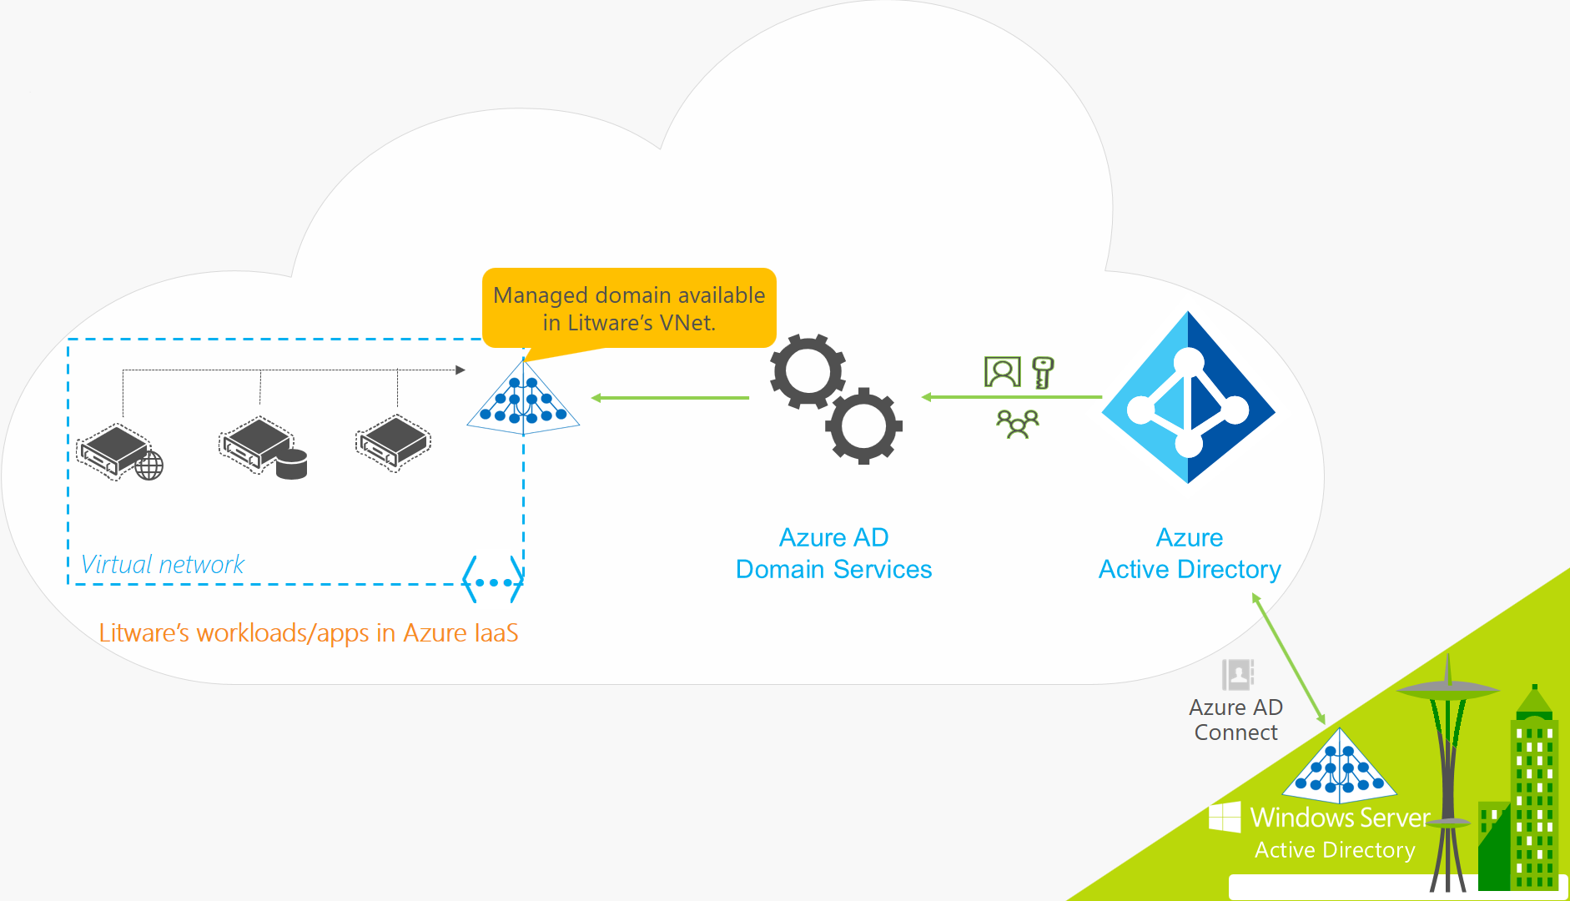
Azure AD Domain Services

Slide 40
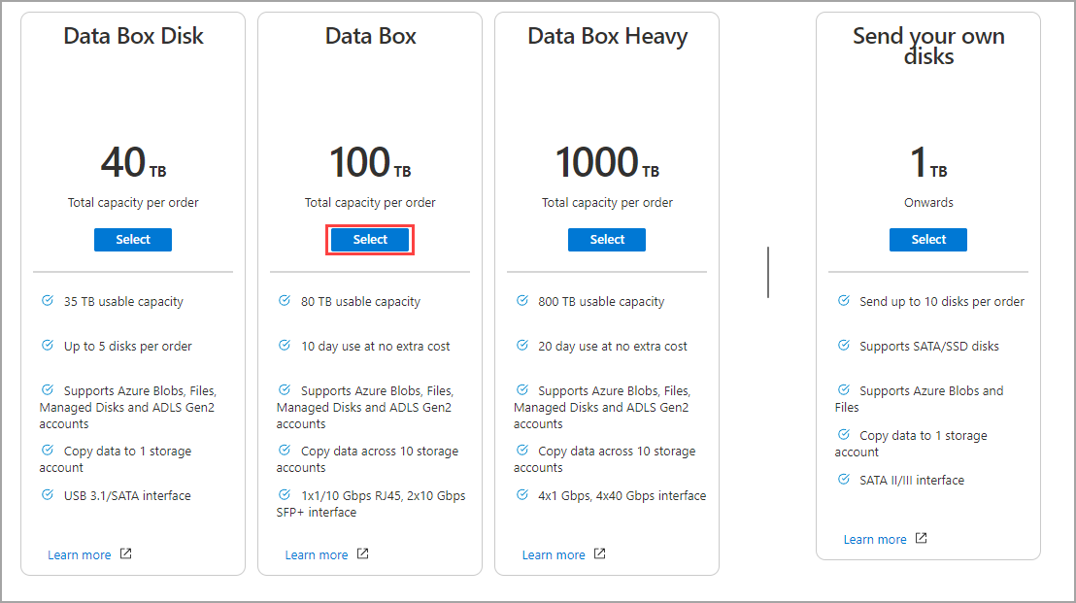
Azure Data Box

Slide 41

Pass-through Authentication

Slide 42

Seamless Single Sign-on

Slide 43

Azure Management Scopes
/ Tenant Root

Slide 44

Data Pipelines

Slide 45
Storage Account Replication
1
3
3
2
LRS
ZRS

Slide 46
Storage Account Replication
3
3
GRS/RA-GRS

Slide 47
Storage Account Replication
1
3
1
3
2
2
GZRS – RA/GZRS

Slide 48

Always Encrypted

Slide 49
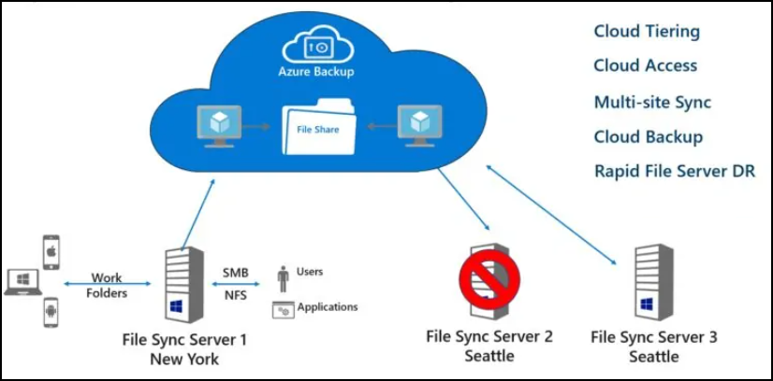
Azure File Sync

Slide 50
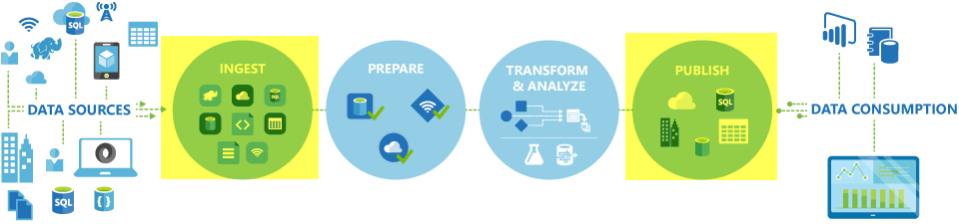
Azure Data Factory

Slide 51

Event Architecture

Slide 52

Event Architecture

Slide 53
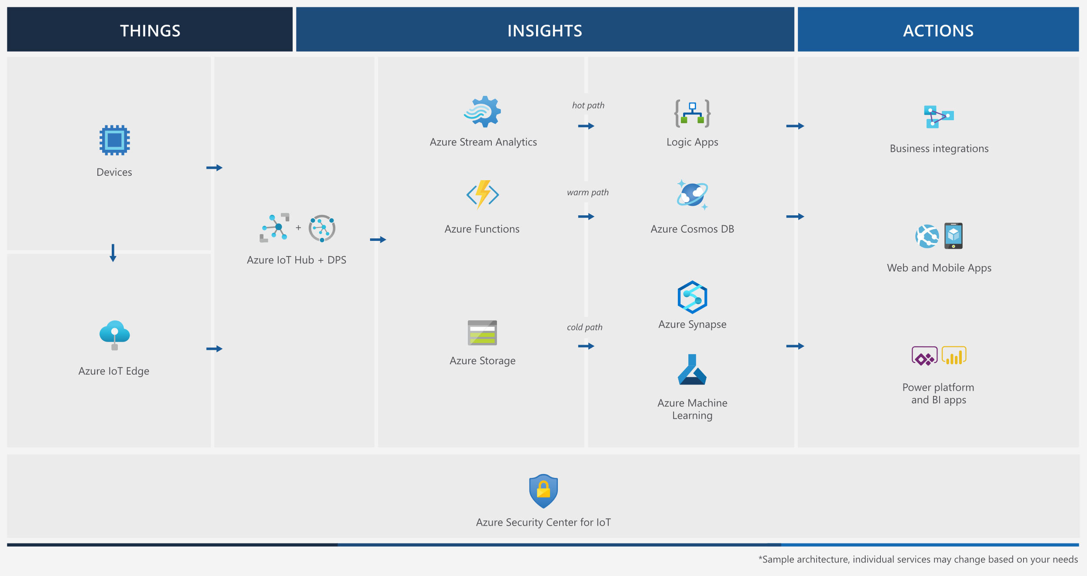
Event Architecture

Slide 54
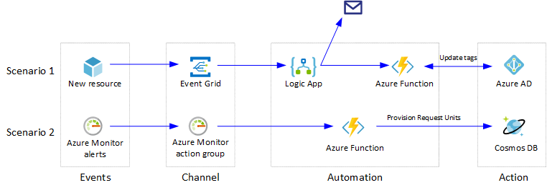
Event Architecture

Slide 55
Exam AZ-304 Item Types

Slide 56

Multiple Choice

Slide 57
Repeated Scenario
You need to move an Azure VM to another hardware host.
Solution: You redeploy the VM.
Does this solution meet the goal?
Yes
No

Slide 58

Select and Place

Slide 59

Build List and Reorder

Slide 60

Active Screen/Fill in the Blank

Slide 61

Case Study

Slide 62






Performance-Based Lab

Slide 63
Microsoft Online Testing

Slide 64
Microsoft Online Testing Process
timw.info/online

Slide 65

Microsoft Online Testing Process

Slide 66

Microsoft Online Testing Process

Slide 67

Microsoft Online Testing Process

Slide 68

Microsoft Online Testing Process

Slide 69

Microsoft Online Testing Process

Slide 70

Microsoft Online Testing Process

Slide 71

Microsoft Online Testing Process

Slide 72
AZ-304 Exam Strategy
Focus your skills accordingly:
60 percent Azure portal
20 percent Azure PowerShell
10 percent Azure CLI
10 percent KQL
Expect performance-based labs, but be thankful if you don't see 'em

